Slide 1
Shalom School of Theology (SSOT)
1689 Baptist Confession of Faith
Chapter 5 ~ Of Divine Providence

Slide 2
Orthodox Catechism
Q26. What is the providence of God?
The almighty power of God, everywhere present, whereby He does, as it were, by His hand uphold and govern heaven and earth, with all creatures therein, so that those things which grow in the earth, as likewise rain and drought, fruitfulness and barrenness, meat and drink, health and sickness, riches and poverty, in a word, all things come not rashly and by chance, but by His fatherly counsel and will
(Psalm 94:9, Isaiah 29:15, Ezekiel 8:12; Acts 17:25
Hebrews 1:2-3
Proverbs 22:2; Jeremiah 5:24; John 9:3; Acts 14:17)

Slide 3
Orthodox Catechism
Q27. What does this knowledge of the creation and providence of God profit us?
That in adversity we may be patient, and thankful in prosperity, and have hereafter our chief hope reposed in God our most faithful Father. We can be sure that there is nothing which may withdraw us from His love, forasmuch as all creatures are so in His power, that without His will they are not able not only to do anything, but not so much as once to move.
(Job 1:21, Romans 5:3
Deuteronomy 8:10, 1 Thessalonians 5:18
Romans 5:4-5
Romans 8:19, 38
Job 1:12, 2:6, Proverbs 21:1. Acts 17:27)

Slide 4
Without boundary or qualification, the Scriptures proclaim, “The Lord reigneth.” God is in control of all things and all events, whether it is a great fish swallowing a disobedient man (Jonah 1:17) or a small fish being caught with a coin in its mouth just in time to pay the taxes of the one obedient man (Matt. 17:24–27). God reigns in all places because He is God in all places—the omnipresent Lord.

Slide 5
He is the only true God and Lord, for all places and powers are subject to his will, authority, and power (Pss. 95:3–5; 96:4–6; 97:5–9). William Plumer said, “We need never fear that God will be dethroned, or overreached, or defeated. He is the Most High [Ps. 9:2].”
The only way to study this doctrine . . .
is with a heart prostrate before God
and a mouth confessing Him as Lord.
Joel BEEKE

Slide 6
Last Session
C5 Para 1. God the good Creator of all things, in His infinite power and wisdom, upholds, directs, disposes, and governs all creatures and things, from the greatest even to the least, by His most wise and holy providence, to the end for the which they were created, according unto his infallible foreknowledge, and the free and immutable counsel of His own will; to the praise of the glory of His wisdom, power, justice, infinite goodness, and mercy.
C5 Para 2. Although in relation to the foreknowledge and decree of God, the first cause, all things come to pass immutably and infallibly; so that there is not anything befalls any by chance, or without his providence; yet by the same providence he ordereth them to fall out according to the nature of second causes, either necessarily, freely, or contingently.
==========
C5 Para 3. God, in His ordinary providence maketh use of means, yet is free to work without, above, and against them at his pleasure.

Slide 7
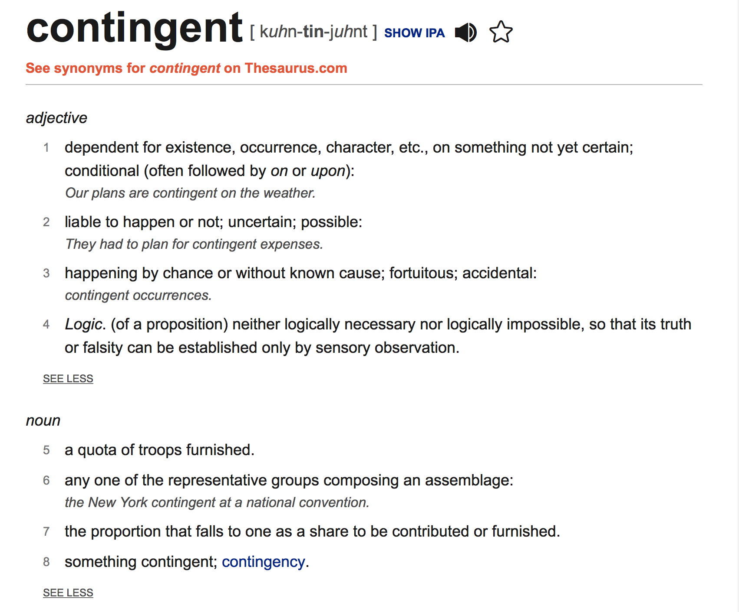

Slide 8
C5 Para 2. Although in relation to the foreknowledge and decree of God, the first cause, all things come to pass immutably and infallibly; so that there is not anything befalls any by chance, or without his providence; yet by the same providence he ordereth them to fall out according to the nature of second causes, either necessarily, freely, or contingently.

Slide 9
C5 Para 2. Although in relation to the foreknowledge and decree of God, the first cause, all things come to pass immutably and infallibly; so that there is not anything befalls any by chance, or without his providence; yet by the same providence he ordereth them to fall out according to the nature of second causes, either necessarily, freely, or contingently.

Slide 10
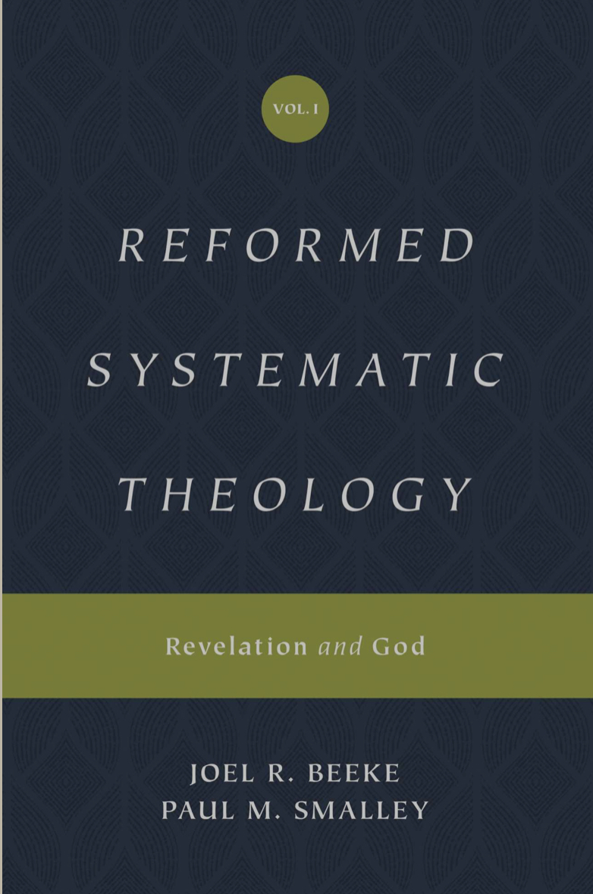
C5 Para 2. Although in relation to the foreknowledge and decree of God, the first cause, all things come to pass immutably and infallibly; so that there is not anything befalls any by chance, or without his providence; yet by the same providence he ordereth them to fall out according to the nature of second causes, either necessarily, freely, or contingently.
“Necessary secondary causes are what we call the laws of nature.
Free secondary causes are the choices of angelic or human wills.
Contingent secondary causes are what we call accidents or random, chaotic events.”

Slide 11
C5 Para 2. Although in relation to the foreknowledge and decree of God, the first cause, all things come to pass immutably and infallibly; so that there is not anything befalls any by chance, or without his providence; yet by the same providence he ordereth them to fall out according to the nature of second causes, either necessarily, freely, or contingently.
One of the most striking categories of providence is God’s working in contingent, apparently random events . Ruth went out to glean, and “she happened to come to the part of the field belonging to Boaz” (Ruth 2:3 ESV). The two married and became the great grandparents of David.
Saul chose a cave in which to relieve himself, and it happened to be the cave where David was hidden—this was from the Lord (1 Sam. 24:10).

Slide 12
C5 Para 2. Although in relation to the foreknowledge and decree of God, the first cause, all things come to pass immutably and infallibly; so that there is not anything befalls any by chance, or without his providence; yet by the same providence he ordereth them to fall out according to the nature of second causes, either necessarily, freely, or contingently.
Though Ahab disguised himself in battle, an archer’s arrow still pierced him at the joint of his armor so that he died, as God’s prophet had foretold
(1 Kings 22:17, 20, 34–37).
If a man cut wood and the axe head slipped from the handle and killed another man, humanly speaking it was an accident that excused the man from the guilt of premeditated murder, but it was still an act of God
(Ex. 21:13; Deut. 19:5).

Slide 13
C5 Para 2. Although in relation to the foreknowledge and decree of God, the first cause, all things come to pass immutably and infallibly; so that there is not anything befalls any by chance, or without his providence; yet by the same providence he ordereth them to fall out according to the nature of second causes, either necessarily, freely, or contingently.
John Flavel noted how God often uses apparently random events to bring people to himself. We see this in the Bible:
A Syrian commander captures a girl from Israel and makes her his slave, only to learn from her of the prophet whose God can heal his leprosy (2 Kings 5:1–4)
A woman walks to the village well at midday and happens to meet a stranger, who offers her living water (John 4:1–14)
An Ethiopian returning home from Jerusalem is reading Isaiah 53 when an evangelist meets him on the road (Acts 8:26–31).

Slide 14
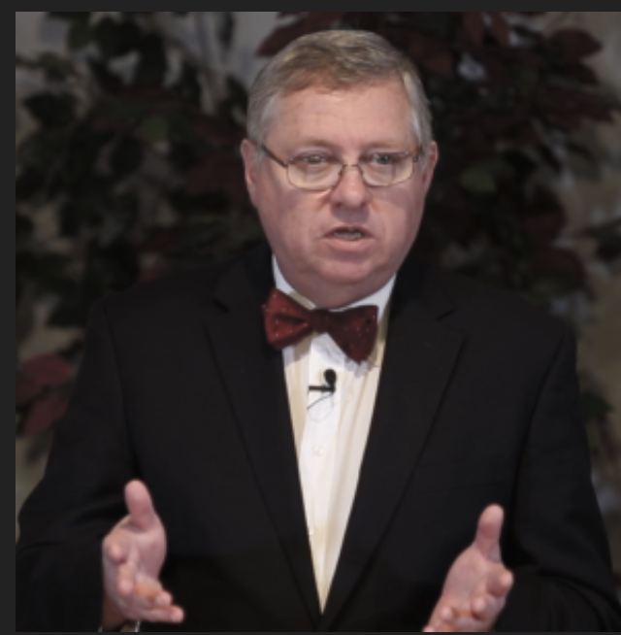
C5 Para 2. Although in relation to the foreknowledge and decree of God, the first cause, all things come to pass immutably and infallibly; so that there is not anything befalls any by chance, or without his providence; yet by the same providence he ordereth them to fall out according to the nature of second causes, either necessarily, freely, or contingently.
B. Second Cause in Providence: The Decree of God. But this doctrine does not remove the reality of second causes. Notice the last word: contingently. Why is it there? Cf. 1 Kings 22:17-37. What was, from a human perspective, a random event, was at the same time the divine plan. That soldier did not aim at the king, but he killed him. We do not in any way deny the reality of 2nd causes—God uses them to accomplish his will. So, on the one hand, the geologist can tell us why an earthquake takes place, and we can receive his words as the truth. But we also know that God caused that earthquake to happen through those natural means.

Slide 15
4. The almighty power, unsearchable wisdom, and infinite goodness of God, so far manifest themselves in his providence, that his determinate counsel extendeth itself even to the first fall, and all other sinful actions both of angels and men; and that not by a bare permission, which also he most wisely and powerfully boundeth, and otherwise ordereth and governeth, in a manifold dispensation to his most holy ends; yet so, as the sinfulness of their acts proceedeth only from the creatures, and not from God, who, being most holy and righteous, neither is nor can be the author or approver of sin.
(Romans 11:32-34; 2 Samuel 24:1; 1 Chronicles 21:1; 2 Kings 19:28; Psalm 76:10; Genesis 1:20; Isaiah 10:6, 7, 12; Psalm 1:21; 1 John 2:16)

Slide 16
4. The almighty power, unsearchable wisdom, and infinite goodness of God, so far manifest themselves in his providence, that his determinate counsel extendeth itself even to the first fall, and all other sinful actions both of angels and men; and that not by a bare permission, which also he most wisely and powerfully boundeth, and otherwise ordereth and governeth, in a manifold dispensation to his most holy ends; yet so, as the sinfulness of their acts proceedeth only from the creatures, and not from God, who, being most holy and righteous, neither is nor can be the author or approver of sin.
(Romans 11:32-34; 2 Samuel 24:1; 1 Chronicles 21:1; 2 Kings 19:28; Psalm 76:10; Genesis 1:20; Isaiah 10:6, 7, 12; Psalm 1:21; 1 John 2:16)

Slide 17
4. The almighty power, unsearchable wisdom, and infinite goodness of God, so far manifest themselves in his providence, that his determinate counsel extendeth itself even to the first fall, and all other sinful actions both of angels and men; and that not by a bare permission, which also he most wisely and powerfully boundeth, and otherwise ordereth and governeth, in a manifold dispensation to his most holy ends; yet so, as the sinfulness of their acts proceedeth only from the creatures, and not from God, who, being most holy and righteous, neither is nor can be the author or approver of sin.
(Romans 11:32-34; 2 Samuel 24:1; 1 Chronicles 21:1; 2 Kings 19:28; Psalm 76:10; Genesis 1:20; Isaiah 10:6, 7, 12; Psalm 1:21; 1 John 2:16)

Slide 18
4. The almighty power, unsearchable wisdom, and infinite goodness of God, so far manifest themselves in his providence, that his determinate counsel extendeth itself even to the first fall, and all other sinful actions both of angels and men; and that not by a bare permission, which also he most wisely and powerfully boundeth, and otherwise ordereth and governeth, in a manifold dispensation to his most holy ends; yet so, as the sinfulness of their acts proceedeth only from the creatures, and not from God, who, being most holy and righteous, neither is nor can be the author or approver of sin.
(Romans 11:32-34; 2 Samuel 24:1; 1 Chronicles 21:1; 2 Kings 19:28; Psalm 76:10; Genesis 1:20; Isaiah 10:6, 7, 12; Psalm 1:21; 1 John 2:16)

Slide 19
4. The almighty power, unsearchable wisdom, and infinite goodness of God, so far manifest themselves in his providence, that his determinate counsel extendeth itself even to the first fall, and all other sinful actions both of angels and men; and that not by a bare permission, which also he most wisely and powerfully boundeth, and otherwise ordereth and governeth, in a manifold dispensation to his most holy ends; yet so, as the sinfulness of their acts proceedeth only from the creatures, and not from God, who, being most holy and righteous, neither is nor can be the author or approver of sin.
(Romans 11:32-34; 2 Samuel 24:1; 1 Chronicles 21:1; 2 Kings 19:28; Psalm 76:10; Genesis 1:20; Isaiah 10:6, 7, 12; Psalm 1:21; 1 John 2:16)

Slide 20
4. The almighty power, unsearchable wisdom, and infinite goodness of God, so far manifest themselves in his providence, that his determinate counsel extendeth itself even to the first fall, and all other sinful actions both of angels and men; and that not by a bare permission, which also he most wisely and powerfully boundeth, and otherwise ordereth and governeth, in a manifold dispensation to his most holy ends; yet so, as the sinfulness of their acts proceedeth only from the creatures, and not from God, who, being most holy and righteous, neither is nor can be the author or approver of sin.
(Romans 11:32-34; 2 Samuel 24:1; 1 Chronicles 21:1; 2 Kings 19:28; Psalm 76:10; Genesis 1:20; Isaiah 10:6, 7, 12; Psalm 1:21; 1 John 2:16)

Slide 21
4. The almighty power, unsearchable wisdom, and infinite goodness of God, so far manifest themselves in his providence, that his determinate counsel extendeth itself even to the first fall, and all other sinful actions both of angels and men; and that not by a bare permission, which also he most wisely and powerfully boundeth, and otherwise ordereth and governeth, in a manifold dispensation to his most holy ends; yet so, as the sinfulness of their acts proceedeth only from the creatures, and not from God, who, being most holy and righteous, neither is nor can be the author or approver of sin.
(Romans 11:32-34; 2 Samuel 24:1; 1 Chronicles 21:1; 2 Kings 19:28; Psalm 76:10; Genesis 1:20; Isaiah 10:6, 7, 12; Psalm 1:21; 1 John 2:16)

Slide 22
4. The almighty power, unsearchable wisdom, and infinite goodness of God, so far manifest themselves in his providence, that his determinate counsel extendeth itself even to the first fall, and all other sinful actions both of angels and men; and that not by a bare permission, which also he most wisely and powerfully boundeth, and otherwise ordereth and governeth, in a manifold dispensation to his most holy ends; yet so, as the sinfulness of their acts proceedeth only from the creatures, and not from God, who, being most holy and righteous, neither is nor can be the author or approver of sin.
(Romans 11:32-34; 2 Samuel 24:1; 1 Chronicles 21:1; 2 Kings 19:28; Psalm 76:10; Genesis 1:20; Isaiah 10:6, 7, 12; Psalm 1:21; 1 John 2:16)
1 Chronicles 21:1-2, 7-8
Acts 2:23
Genesis 45:5
Acts 4:27-28
Genesis 50:20
1 John 2:16
2 Samuel 24:1, 10
James 1:13-14
Psalm 76:10
(KJV)
Isaiah 10:5-7
1 Chronicles 10:4, 13-14

Slide 24
5. The most wise, righteous, and gracious God doth oftentimes leave for a season his own children to manifold temptations and the corruptions of their own hearts, to chastise them for their former sins, or to discover unto them the hidden strength of corruption and deceitfulness of their hearts, that they may be humbled; and to raise them to a more close and constant dependence for their support upon himself; and to make them more watchful against all future occasions of sin, and for other just and holy ends. So that whatsoever befalls any of his elect is by his appointment, for his glory, and their good.
(2 Chronicles 32:25, 26, 31; 2 Corinthians 12:7-9; Romans 8:28)

Slide 25
5. The most wise, righteous, and gracious God doth oftentimes leave for a season his own children to manifold temptations and the corruptions of their own hearts, to chastise them for their former sins, or to discover unto them the hidden strength of corruption and deceitfulness of their hearts, that they may be humbled; and to raise them to a more close and constant dependence for their support upon himself; and to make them more watchful against all future occasions of sin, and for other just and holy ends. So that whatsoever befalls any of his elect is by his appointment, for his glory, and their good.
(2 Chronicles 32:25, 26, 31; 2 Corinthians 12:7-9; Romans 8:28)

Slide 26
5. The most wise, righteous, and gracious God doth oftentimes leave for a season his own children to manifold temptations and the corruptions of their own hearts, to chastise them for their former sins, or to discover unto them the hidden strength of corruption and deceitfulness of their hearts, that they may be humbled; and to raise them to a more close and constant dependence for their support upon himself; and to make them more watchful against all future occasions of sin, and for other just and holy ends. So that whatsoever befalls any of his elect is by his appointment, for his glory, and their good.
(2 Chronicles 32:25, 26, 31; 2 Corinthians 12:7-9; Romans 8:28)

Slide 27
5. The most wise, righteous, and gracious God doth oftentimes leave for a season his own children to manifold temptations and the corruptions of their own hearts, to chastise them for their former sins, or to discover unto them the hidden strength of corruption and deceitfulness of their hearts, that they may be humbled; and to raise them to a more close and constant dependence for their support upon himself; and to make them more watchful against all future occasions of sin, and for other just and holy ends. So that whatsoever befalls any of his elect is by his appointment, for his glory, and their good.
(2 Chronicles 32:25, 26, 31; 2 Corinthians 12:7-9; Romans 8:28)

Slide 28
5. The most wise, righteous, and gracious God doth oftentimes leave for a season his own children to manifold temptations and the corruptions of their own hearts, to chastise them for their former sins, or to discover unto them the hidden strength of corruption and deceitfulness of their hearts, that they may be humbled; and to raise them to a more close and constant dependence for their support upon himself; and to make them more watchful against all future occasions of sin, and for other just and holy ends. So that whatsoever befalls any of his elect is by his appointment, for his glory, and their good.
(2 Chronicles 32:25, 26, 31; 2 Corinthians 12:7-9; Romans 8:28)

Slide 29
5. The most wise, righteous, and gracious God doth oftentimes leave for a season his own children to manifold temptations and the corruptions of their own hearts, to chastise them for their former sins, or to discover unto them the hidden strength of corruption and deceitfulness of their hearts, that they may be humbled; and to raise them to a more close and constant dependence for their support upon himself; and to make them more watchful against all future occasions of sin, and for other just and holy ends. So that whatsoever befalls any of his elect is by his appointment, for his glory, and their good.
(2 Chronicles 32:25, 26, 31; 2 Corinthians 12:7-9; Romans 8:28)

Slide 30
5. The most wise, righteous, and gracious God doth oftentimes leave for a season his own children to manifold temptations and the corruptions of their own hearts, to chastise them for their former sins, or to discover unto them the hidden strength of corruption and deceitfulness of their hearts, that they may be humbled; and to raise them to a more close and constant dependence for their support upon himself; and to make them more watchful against all future occasions of sin, and for other just and holy ends. So that whatsoever befalls any of his elect is by his appointment, for his glory, and their good.
(2 Chronicles 32:25, 26, 31; 2 Corinthians 12:7-9; Romans 8:28)
²⁴ In those days Hezekiah was sick and near death, and he prayed to the Lord; and He spoke to him and gave him a sign. ²⁵ But Hezekiah did not repay according to the favour shown him, for his heart was lifted up; therefore wrath was looming over him and over Judah and Jerusalem. ²⁶ Then Hezekiah humbled himself for the pride of his heart, he and the inhabitants of Jerusalem, so that the wrath of the Lord did not come upon them in the days of Hezekiah.
2 Chronicles 32

Slide 31
5. The most wise, righteous, and gracious God doth oftentimes leave for a season his own children to manifold temptations and the corruptions of their own hearts, to chastise them for their former sins, or to discover unto them the hidden strength of corruption and deceitfulness of their hearts, that they may be humbled; and to raise them to a more close and constant dependence for their support upon himself; and to make them more watchful against all future occasions of sin, and for other just and holy ends. So that whatsoever befalls any of his elect is by his appointment, for his glory, and their good.
(2 Chronicles 32:25, 26, 31; 2 Corinthians 12:7-9; Romans 8:28)
²⁴ In those days Hezekiah was sick and near death, and he prayed to the Lord; and He spoke to him and gave him a sign. ²⁵ But Hezekiah did not repay according to the favour shown him, for his heart was lifted up; therefore wrath was looming over him and over Judah and Jerusalem. ²⁶ Then Hezekiah humbled himself for the pride of his heart, he and the inhabitants of Jerusalem, so that the wrath of the Lord did not come upon them in the days of Hezekiah.
2 Chronicles 32

Slide 32
5. The most wise, righteous, and gracious God doth oftentimes leave for a season his own children to manifold temptations and the corruptions of their own hearts, to chastise them for their former sins, or to discover unto them the hidden strength of corruption and deceitfulness of their hearts, that they may be humbled; and to raise them to a more close and constant dependence for their support upon himself; and to make them more watchful against all future occasions of sin, and for other just and holy ends. So that whatsoever befalls any of his elect is by his appointment, for his glory, and their good.
(2 Chronicles 32:25, 26, 31; 2 Corinthians 12:7-9; Romans 8:28)
²⁴ In those days Hezekiah was sick and near death, and he prayed to the Lord; and He spoke to him and gave him a sign. ²⁵ But Hezekiah did not repay according to the favour shown him, for his heart was lifted up; therefore wrath was looming over him and over Judah and Jerusalem. ²⁶ Then Hezekiah humbled himself for the pride of his heart, he and the inhabitants of Jerusalem, so that the wrath of the Lord did not come upon them in the days of Hezekiah.
2 Chronicles 32

Slide 33
5. The most wise, righteous, and gracious God doth oftentimes leave for a season his own children to manifold temptations and the corruptions of their own hearts, to chastise them for their former sins, or to discover unto them the hidden strength of corruption and deceitfulness of their hearts, that they may be humbled; and to raise them to a more close and constant dependence for their support upon himself; and to make them more watchful against all future occasions of sin, and for other just and holy ends. So that whatsoever befalls any of his elect is by his appointment, for his glory, and their good.
(2 Chronicles 32:25, 26, 31; 2 Corinthians 12:7-9; Romans 8:28)
³¹ However, regarding the ambassadors of the princes of Babylon, whom they sent to him to inquire about the wonder that was done in the land,
God withdrew from him, in order to test him,
that He might know all that was in his heart.
2 Chronicles 32

Slide 34
5. The most wise, righteous, and gracious God doth oftentimes leave for a season his own children to manifold temptations and the corruptions of their own hearts, to chastise them for their former sins, or to discover unto them the hidden strength of corruption and deceitfulness of their hearts, that they may be humbled; and to raise them to a more close and constant dependence for their support upon himself; and to make them more watchful against all future occasions of sin, and for other just and holy ends. So that whatsoever befalls any of his elect is by his appointment, for his glory, and their good.
(2 Chronicles 32:25, 26, 31; 2 Corinthians 12:7-9; Romans 8:28)
³¹ However, regarding the ambassadors of the princes of Babylon, whom they sent to him to inquire about the wonder that was done in the land,
God withdrew from him, in order to test him,
that He might know all that was in his heart.
2 Chronicles 32
Cf. Isaiah 39

Slide 35
5. The most wise, righteous, and gracious God doth oftentimes leave for a season his own children to manifold temptations and the corruptions of their own hearts, to chastise them for their former sins, or to discover unto them the hidden strength of corruption and deceitfulness of their hearts, that they may be humbled; and to raise them to a more close and constant dependence for their support upon himself; and to make them more watchful against all future occasions of sin, and for other just and holy ends. So that whatsoever befalls any of his elect is by his appointment, for his glory, and their good.
(2 Chronicles 32:25, 26, 31; 2 Corinthians 12:7-9; Romans 8:28)
³¹ However, regarding the ambassadors of the princes of Babylon, whom they sent to him to inquire about the wonder that was done in the land,
God withdrew from him, in order to test him,
that He might know all that was in his heart.
2 Chronicles 32
Cf. Isaiah 39

Slide 36
5. The most wise, righteous, and gracious God doth oftentimes leave for a season his own children to manifold temptations and the corruptions of their own hearts, to chastise them for their former sins, or to discover unto them the hidden strength of corruption and deceitfulness of their hearts, that they may be humbled; and to raise them to a more close and constant dependence for their support upon himself; and to make them more watchful against all future occasions of sin, and for other just and holy ends. So that whatsoever befalls any of his elect is by his appointment, for his glory, and their good.
(2 Chronicles 32:25, 26, 31; 2 Corinthians 12:7-9; Romans 8:28)
⁷ And lest I should be exalted above measure by the abundance of the revelations, a thorn in the flesh was given to me,
a messenger of Satan to buffet me, lest I be exalted above measure . . .
¹⁰ Therefore I take pleasure in infirmities, in reproaches, in needs, in persecutions, in distresses, for Christ’s sake.
For when I am weak, then I am strong.
2 Corinthians 12

Slide 37
5. The most wise, righteous, and gracious God doth oftentimes leave for a season his own children to manifold temptations and the corruptions of their own hearts, to chastise them for their former sins, or to discover unto them the hidden strength of corruption and deceitfulness of their hearts, that they may be humbled; and to raise them to a more close and constant dependence for their support upon himself; and to make them more watchful against all future occasions of sin, and for other just and holy ends. So that whatsoever befalls any of his elect is by his appointment, for his glory, and their good.
(2 Chronicles 32:25, 26, 31; 2 Corinthians 12:7-9; Romans 8:28)
²⁸ And we know that all things work together for good to those who love God, to those who are the called according to His purpose.
²⁹ For whom He foreknew, He also predestined to be conformed to the image of His Son, that He might be the firstborn among many brethren.
Romans 8

Slide 38
5. The most wise, righteous, and gracious God doth oftentimes leave for a season his own children to manifold temptations and the corruptions of their own hearts, to chastise them for their former sins, or to discover unto them the hidden strength of corruption and deceitfulness of their hearts, that they may be humbled; and to raise them to a more close and constant dependence for their support upon himself; and to make them more watchful against all future occasions of sin, and for other just and holy ends. So that whatsoever befalls any of his elect is by his appointment, for his glory, and their good.
(2 Chronicles 32:25, 26, 31; 2 Corinthians 12:7-9; Romans 8:28)
²⁸ And we know that all things work together for good to those who love God, to those who are the called according to His purpose.
²⁹ For whom He foreknew, He also predestined to be conformed to the image of His Son, that He might be the firstborn among many brethren.
Romans 8

Slide 39
Orthodox Catechism
Question 25:
What do you believe when you say, "I believe in God, the Father almighty, creator of heaven and earth"?
Answer:
That the eternal Father of our Lord Jesus Christ, who out of nothing created heaven and earth and everything in them, who still upholds and rules them by his eternal counsel and providence, is my God and Father because of Christ his Son. I trust him so much that I do not doubt he will provide whatever I need for body and soul, and he will turn to my good whatever adversity he sends me in this sad world. He is able to do this because he is almighty God; he desires to do this because he is a faithful Father.

Slide 41
6. As for those wicked and ungodly men whom God, as the righteous judge, for former sin doth blind and harden; from them he not only withholdeth his grace, whereby they might have been enlightened in their understanding, and wrought upon their hearts; but sometimes also withdraweth the gifts which they had, and exposeth them to such objects as their corruption makes occasion of sin; and withal, gives them over to their own lusts, the temptations of the world, and the power of Satan, whereby it comes to pass that they harden themselves, under those means which God useth for the softening of others.
(Romans 1:24-26, 28; Romans 11:7-8; Deuteronomy 29:4; Matthew 13:2; Deuteronomy 2:20; 2 Kings 8:12-13; Psalm 81:11-12; 2 Thessalonians 2:10-12; Exodus 8:15, 32; Isaiah 6:9-10; 1 Peter 2:7-8)

Slide 42
6. As for those wicked and ungodly men whom God, as the righteous judge, for former sin doth blind and harden; from them he not only withholdeth his grace, whereby they might have been enlightened in their understanding, and wrought upon their hearts; but sometimes also withdraweth the gifts which they had, and exposeth them to such objects as their corruption makes occasion of sin; and withal, gives them over to their own lusts, the temptations of the world, and the power of Satan, whereby it comes to pass that they harden themselves, under those means which God useth for the softening of others.
(Romans 1:24-26, 28; Romans 11:7-8; Deuteronomy 29:4; Matthew 13:2; Deuteronomy 2:20; 2 Kings 8:12-13; Psalm 81:11-12; 2 Thessalonians 2:10-12; Exodus 8:15, 32; Isaiah 6:9-10; 1 Peter 2:7-8)

Slide 43
6. As for those wicked and ungodly men whom God, as the righteous judge, for former sin doth blind and harden; from them he not only withholdeth his grace, whereby they might have been enlightened in their understanding, and wrought upon their hearts; but sometimes also withdraweth the gifts which they had, and exposeth them to such objects as their corruption makes occasion of sin; and withal, gives them over to their own lusts, the temptations of the world, and the power of Satan, whereby it comes to pass that they harden themselves, under those means which God useth for the softening of others.
(Romans 1:24-26, 28; Romans 11:7-8; Deuteronomy 29:4; Matthew 13:2; Deuteronomy 2:20; 2 Kings 8:12-13; Psalm 81:11-12; 2 Thessalonians 2:10-12; Exodus 8:15, 32; Isaiah 6:9-10; 1 Peter 2:7-8)

Slide 44
6. As for those wicked and ungodly men whom God, as the righteous judge, for former sin doth blind and harden; from them he not only withholdeth his grace, whereby they might have been enlightened in their understanding, and wrought upon their hearts; but sometimes also withdraweth the gifts which they had, and exposeth them to such objects as their corruption makes occasion of sin; and withal, gives them over to their own lusts, the temptations of the world, and the power of Satan, whereby it comes to pass that they harden themselves, under those means which God useth for the softening of others.
(Romans 1:24-26, 28; Romans 11:7-8; Deuteronomy 29:4; Matthew 13:2; Deuteronomy 2:20; 2 Kings 8:12-13; Psalm 81:11-12; 2 Thessalonians 2:10-12; Exodus 8:15, 32; Isaiah 6:9-10; 1 Peter 2:7-8)

Slide 45
6. As for those wicked and ungodly men whom God, as the righteous judge, for former sin doth blind and harden; from them he not only withholdeth his grace, whereby they might have been enlightened in their understanding, and wrought upon their hearts; but sometimes also withdraweth the gifts which they had, and exposeth them to such objects as their corruption makes occasion of sin; and withal, gives them over to their own lusts, the temptations of the world, and the power of Satan, whereby it comes to pass that they harden themselves, under those means which God useth for the softening of others.
(Romans 1:24-26, 28; Romans 11:7-8; Deuteronomy 29:4; Matthew 13:2; Deuteronomy 2:20; 2 Kings 8:12-13; Psalm 81:11-12; 2 Thessalonians 2:10-12; Exodus 8:15, 32; Isaiah 6:9-10; 1 Peter 2:7-8)

Slide 46
6. As for those wicked and ungodly men whom God, as the righteous judge, for former sin doth blind and harden; from them he not only withholdeth his grace, whereby they might have been enlightened in their understanding, and wrought upon their hearts; but sometimes also withdraweth the gifts which they had, and exposeth them to such objects as their corruption makes occasion of sin; and withal, gives them over to their own lusts, the temptations of the world, and the power of Satan, whereby it comes to pass that they harden themselves, under those means which God useth for the softening of others.
(Romans 1:24-26, 28; Romans 11:7-8; Deuteronomy 29:4; Matthew 13:2; Deuteronomy 2:20; 2 Kings 8:12-13; Psalm 81:11-12; 2 Thessalonians 2:10-12; Exodus 8:15, 32; Isaiah 6:9-10; 1 Peter 2:7-8)
¹⁴ ¹⁴ Now thanks be to God who always leads us in triumph in Christ, and through us diffuses the fragrance of His knowledge in every place. ¹⁵ For we are to God the fragrance of Christ among those who are being saved and among those who are perishing. ¹⁶ To the one we are the aroma of death leading to death, and to the other the aroma of life leading to life. And who is sufficient for these things?
2 Corinthians 2

Slide 48
7. As the providence of God doth in general reach to all creatures, so after a more special manner it taketh care of his church, and disposeth of all things to the good thereof.
(1 Timothy 4:10; Amos 9:8-9; Isaiah 43:3-5)

Slide 49
7. As the providence of God doth in general reach to all creatures, so after a more special manner it taketh care of his church, and disposeth of all things to the good thereof.
(1 Timothy 4:10; Amos 9:8-9; Isaiah 43:3-5)

Slide 50
7. As the providence of God doth in general reach to all creatures, so after a more special manner it taketh care of his church, and disposeth of all things to the good thereof.
(1 Timothy 4:10; Amos 9:8-9; Isaiah 43:3-5)
ROMANS 8:28-30
EPHESIANS 1:11-12, 22-23

